Slide 1
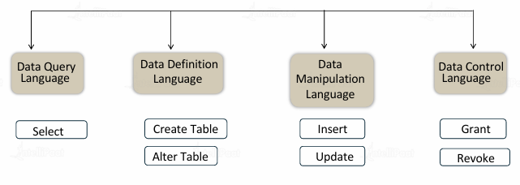
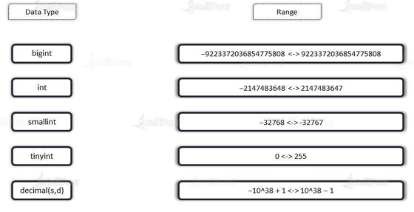
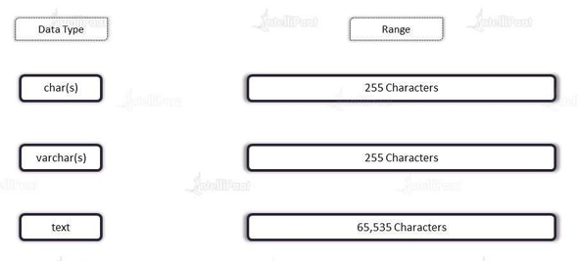
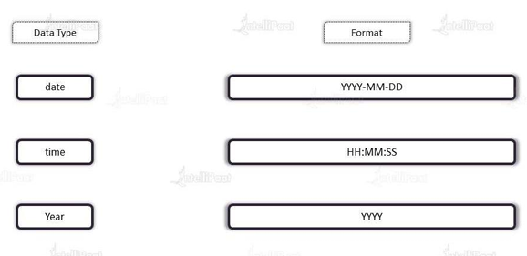
CREATE DATABASE databaseName ;
USE [DataBaseName] ;
DROP DATABASE databasename ;
Constraints: Rules for the data in a table can be specified using SQL constraints. The kinds of data that can be entered into a table are restricted by constraints. This validates the reliability and accuracy of the data in the table
NOT NULL
UNIQUE
PRIMARY KEY
FOREIGN KEY
CHECK
DEFAULT
The foreign key constraint is used to prevent actions that would destroy links between tables.
The foreign key constraint also prevents invalid data from being inserted into the foreign key column, because it has to be one of the values contained in the table it points to.
Bigint
Int
Smallint
Tinyint
Decimal(s,d)
Char(s)
Varchar(s)
text
Date
Time
Year
Name of the table -> define the columns -> Assign data types to columns

Slide 2
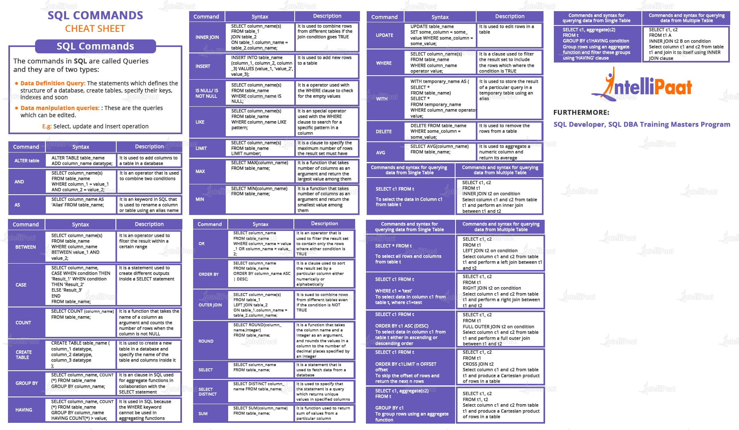

Slide 3
Module 1

Slide 4
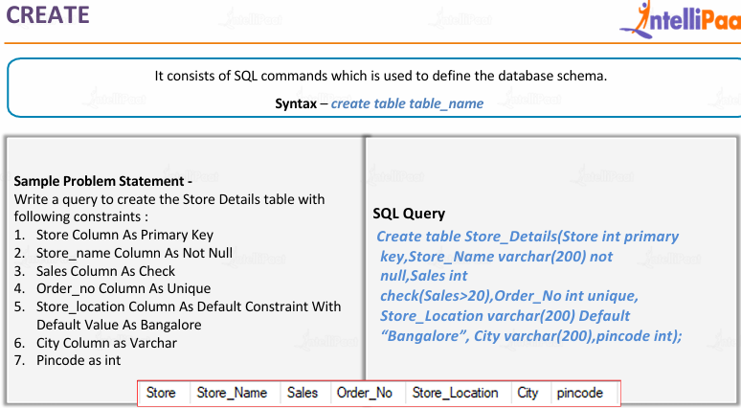
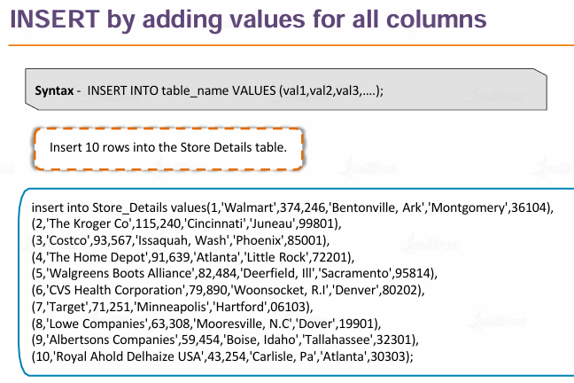
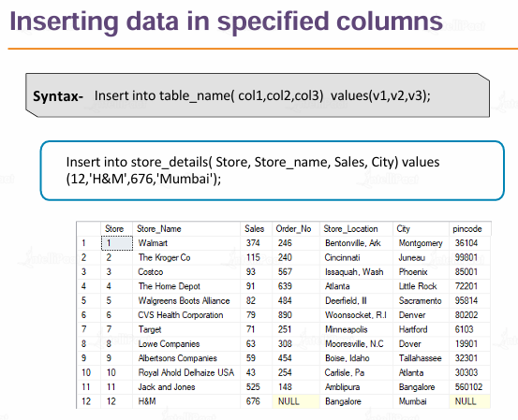
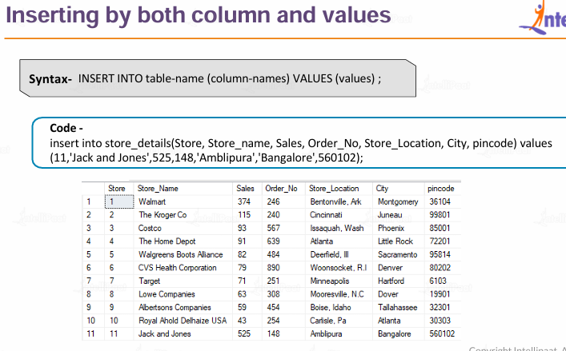

Slide 5
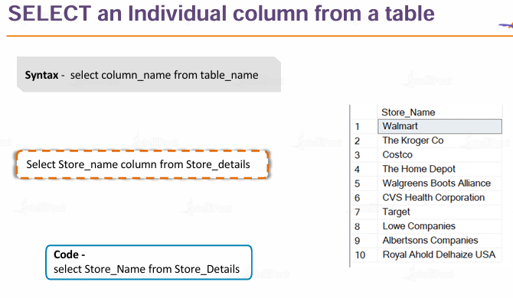
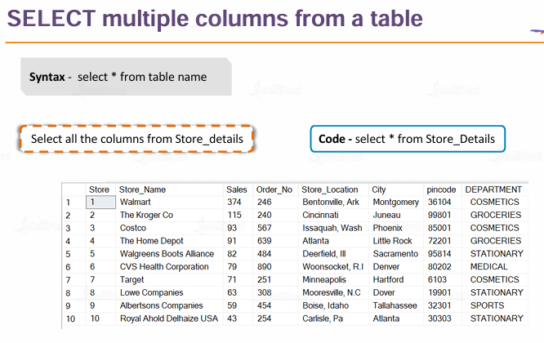
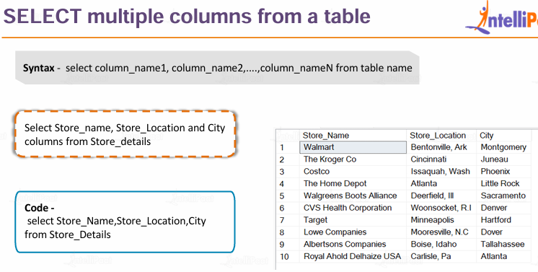

Slide 6
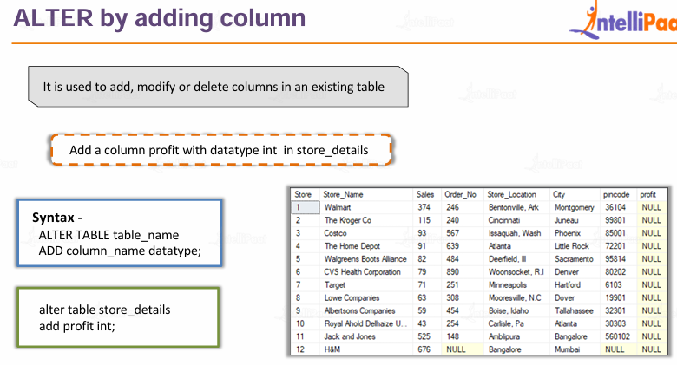
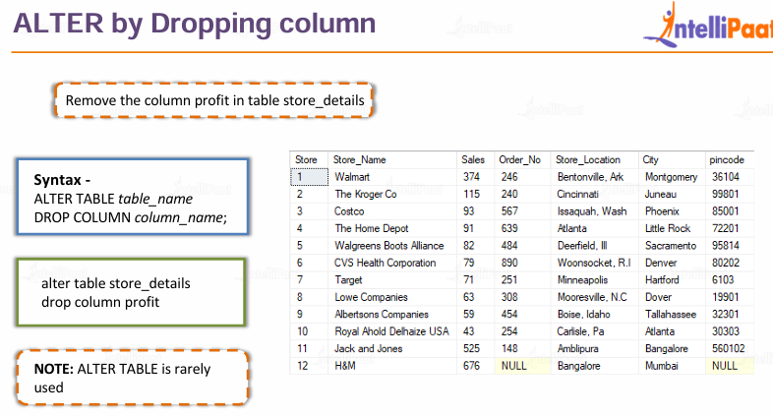

Slide 7
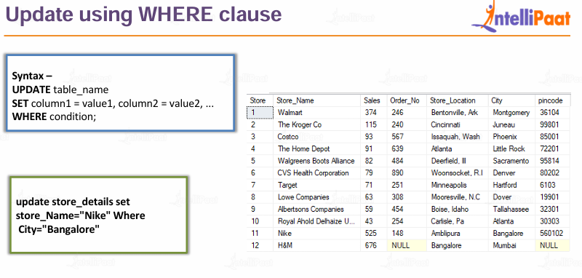
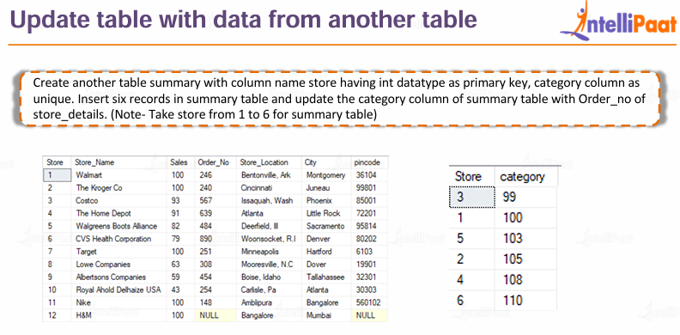
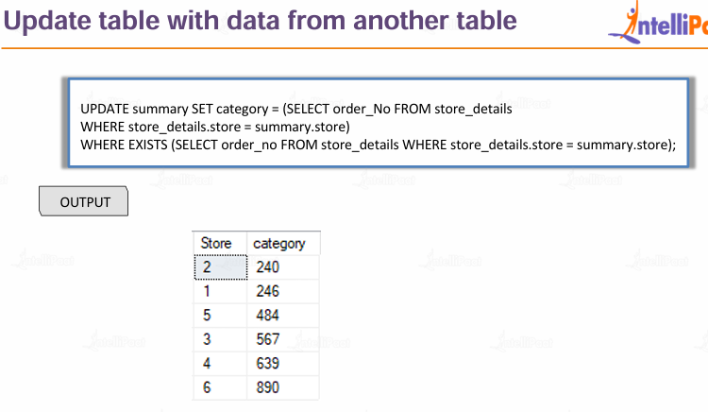
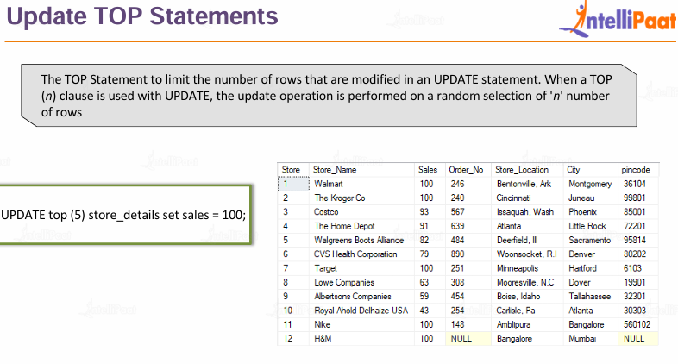
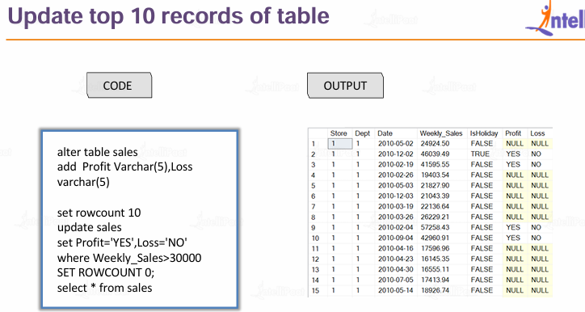

Slide 8
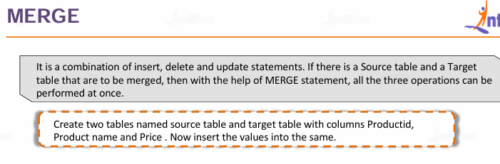
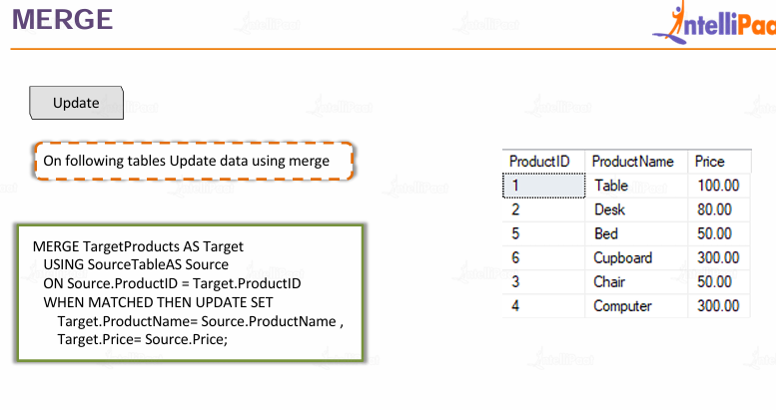
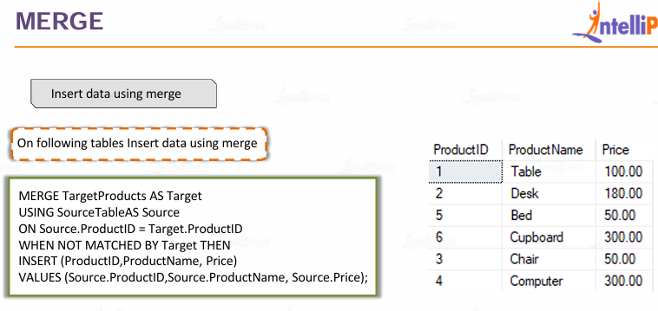
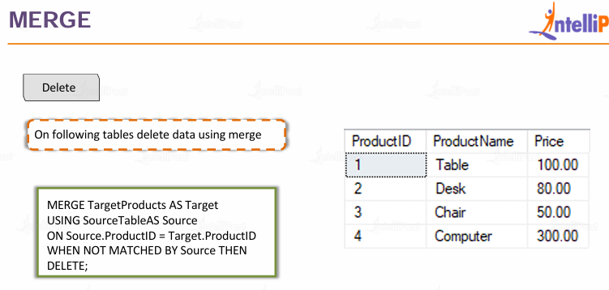

Slide 9
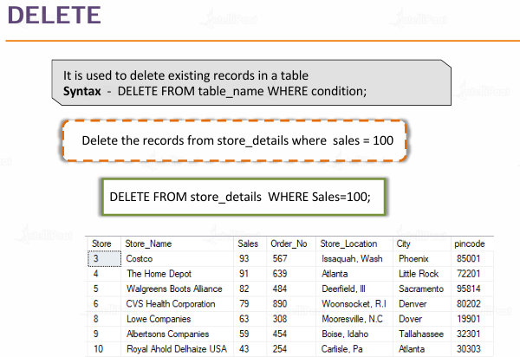
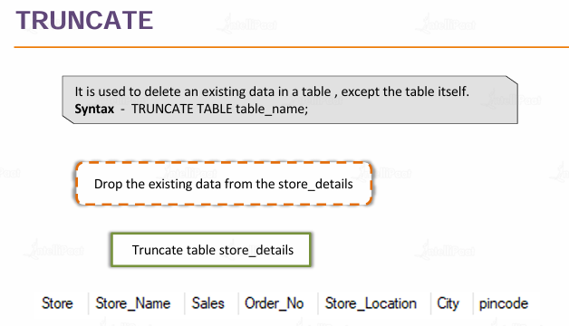
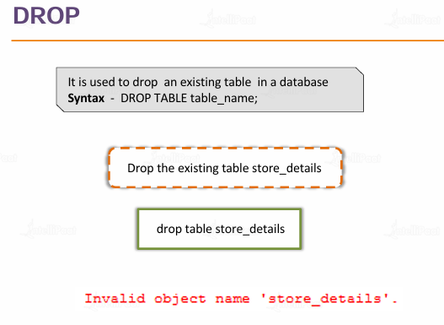

Slide 10
Module 2

Slide 11
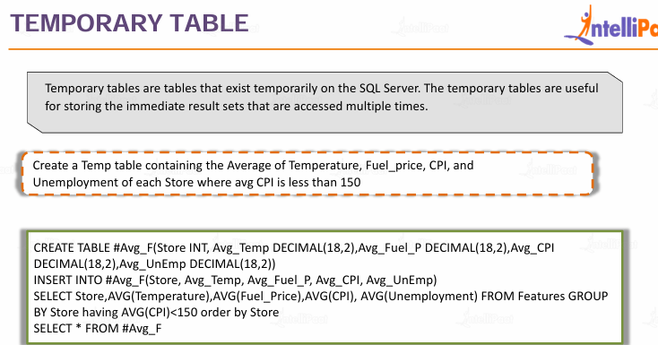
AND
OR
NOT
UNION
UNION ALL
INTERSECT
EXCEPT
LIKE
BETWEEN-Range
IN-List of values
Temporary Table CREATE TABLE #table_name();
WHERE
GROUP BY
ORDER BY
HAVING

Slide 12
Module 3
Joins
INNER JOIN
LEFT JOIN
RIGHT JOIN
FULL JOIN

Slide 13
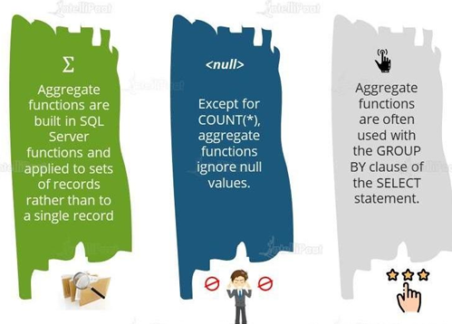
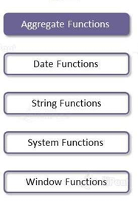
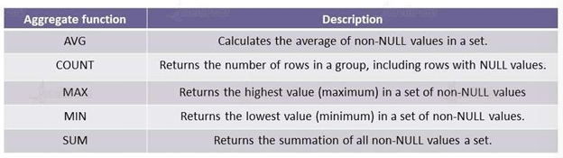
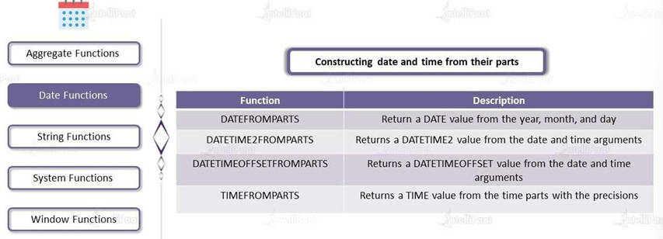
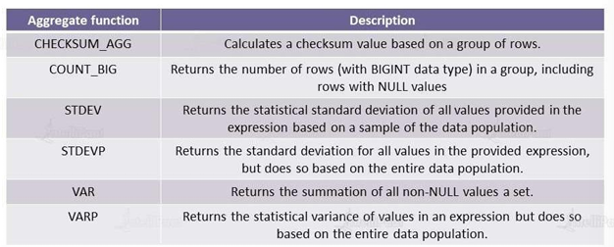
Module 4

Slide 14
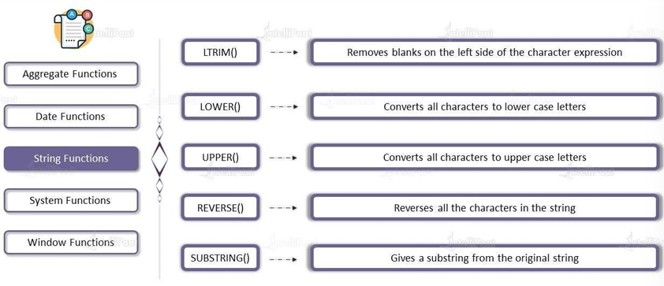
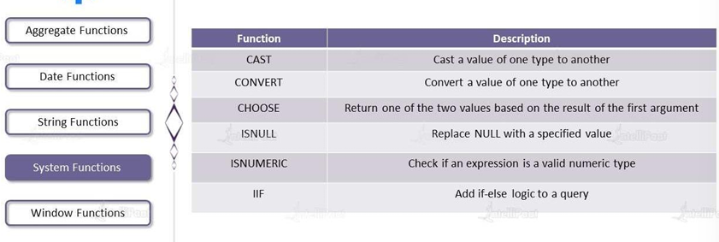
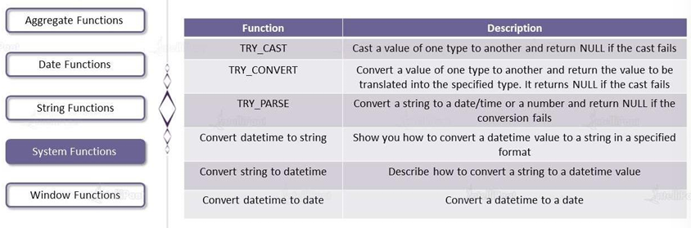

Slide 15
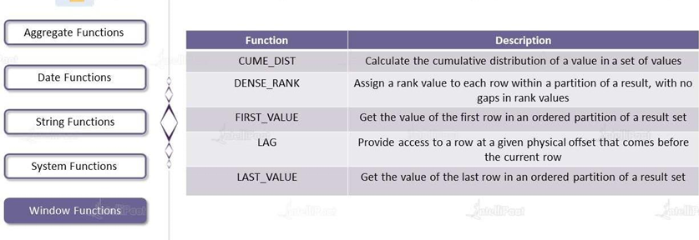
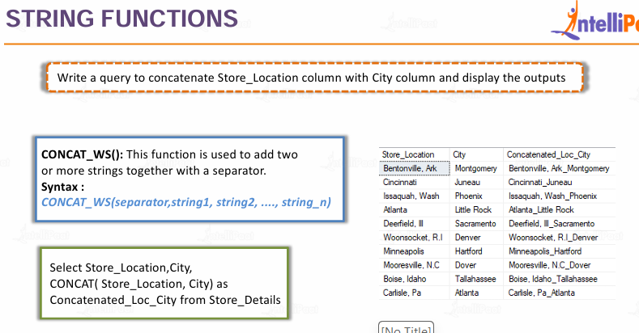
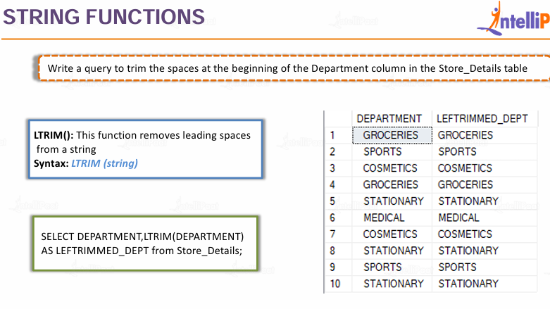
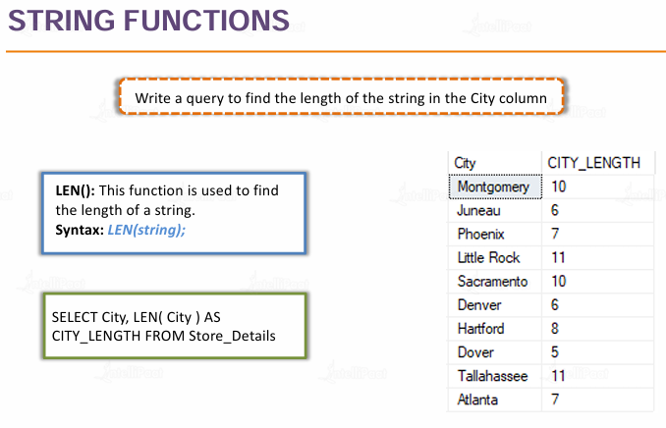
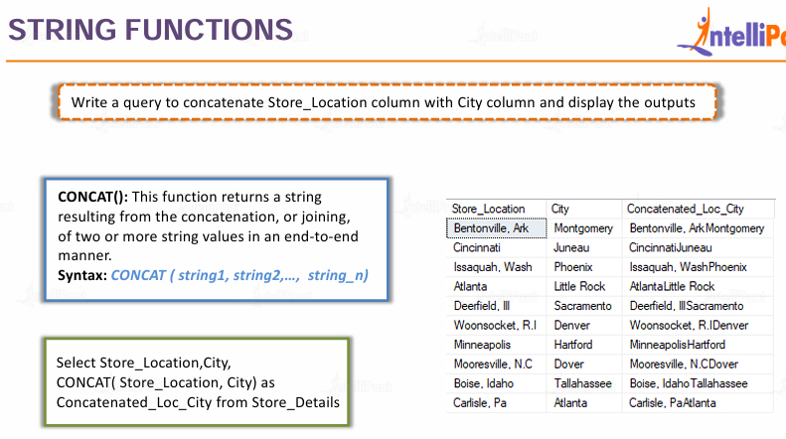
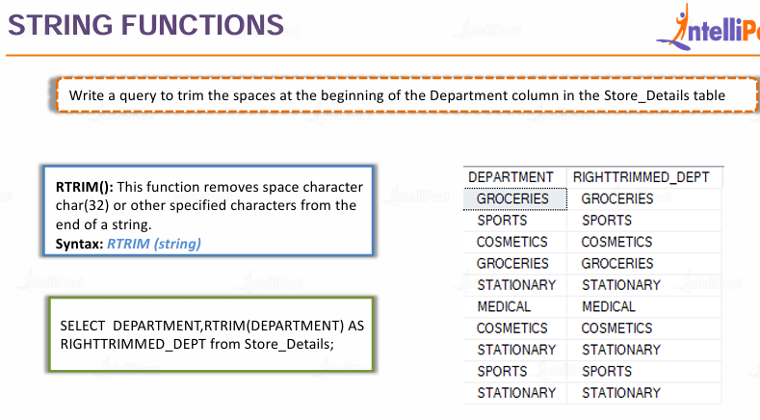

Slide 16
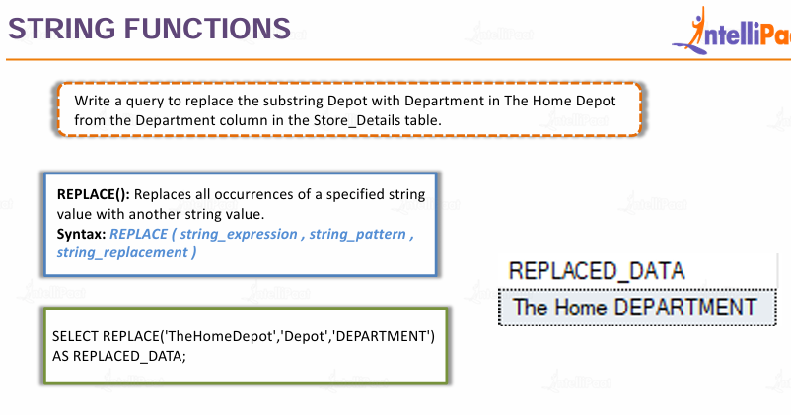
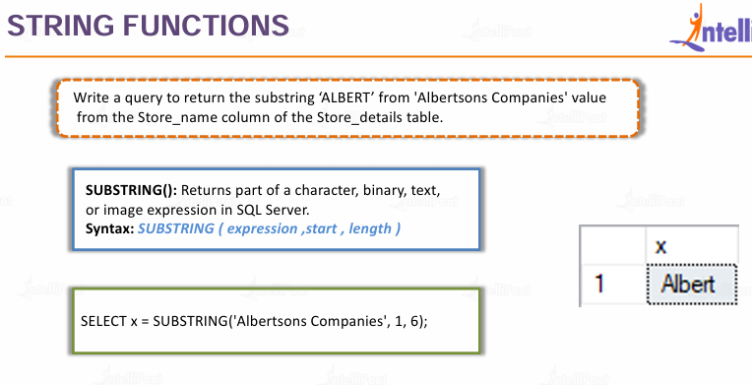
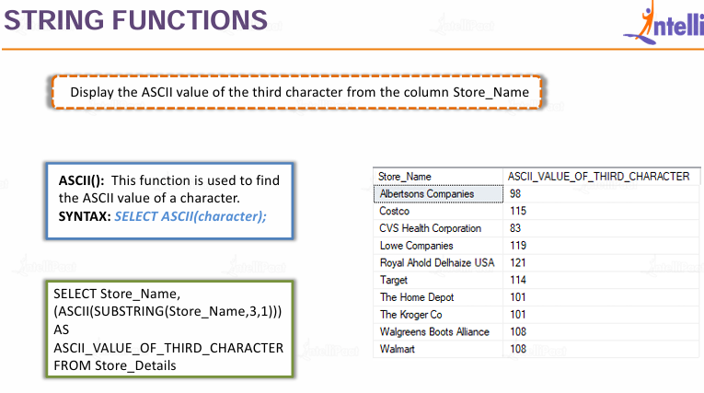
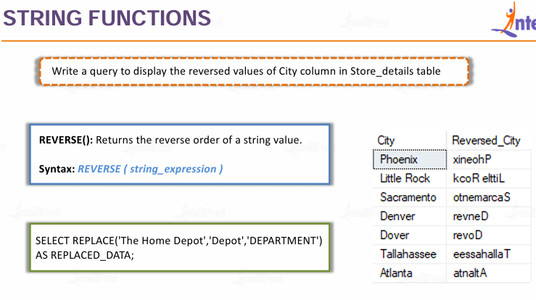

Slide 17
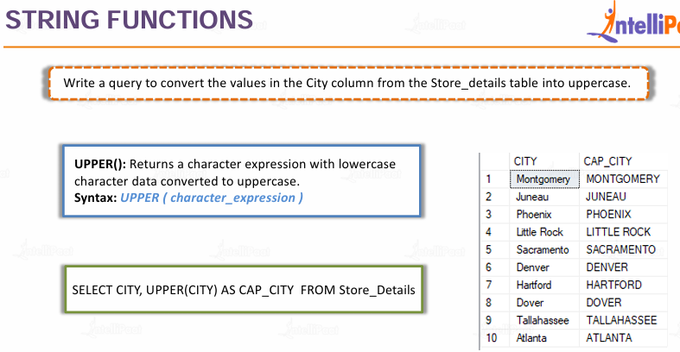
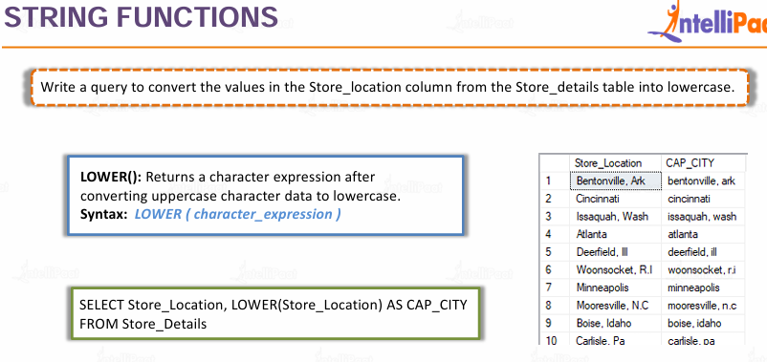

Slide 18
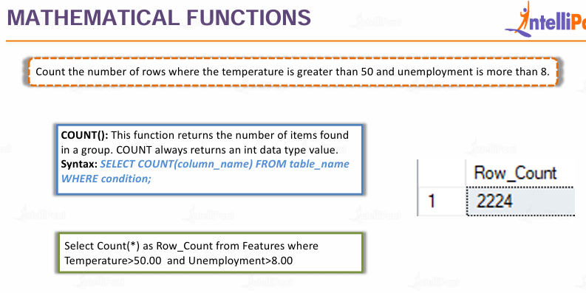
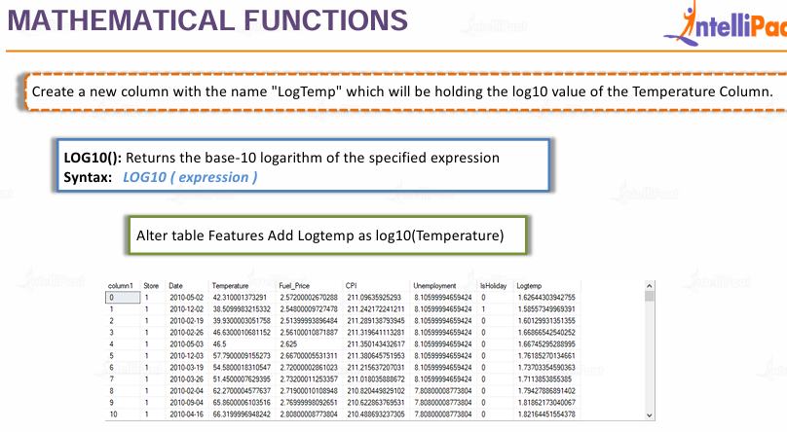
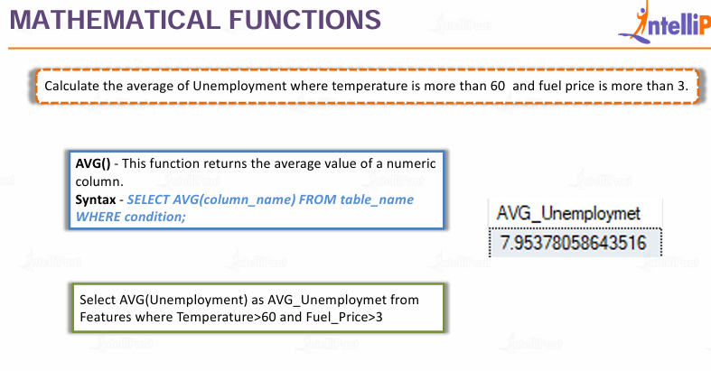



Slide 19





Slide 20








Slide 21



Slide 22





Slide 23




Slide 24





Slide 25
Module 5

Slide 26



Slide 27


Slide 28


Slide 29





Slide 30




Slide 31



Slide 32



Slide 33





Slide 34





Slide 35


Slide 36




Slide 37






Slide 38






Slide 39



Slide 40





Slide 41




Slide 42







Slide 43







Slide 44



Slide 45





Slide 46



Slide 47





Slide 48



Slide 49






Slide 50





Slide 51




Slide 52



Slide 53





Slide 54





Slide 55
Module 6
Additional Learning Resources PPT
Assignments
Test Your self
Case Studies
Projects
Advanced SQL Case Studies Archive

Slide 56





